Slide 1
Wrapping UI Elements in Angular 2 Components
Evan Wallace

Slide 2
What’s to come
Atomic Design
What is it?
How it works well with Angular Components
Why abstract/split UI components
Walk through a demo app that uses Atomic Design and abstract, reusable components
Q&A
Extra Credit
More readings and useful articles to supplement this talk

Slide 3
Atomic Design
Design concepts by Brad Frost
Suggests handling/creating websites in methodical way
Uses smallest possible element
Create groups of these small elements
Create pages from element groups
Very hand in hand with SOLID principles and once we started it at work, unable to go about it another way

Slide 4
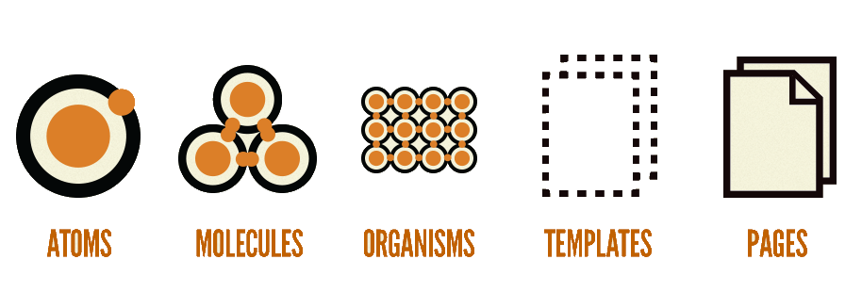
Atomic Design

Slide 5

One Atom

Slide 6
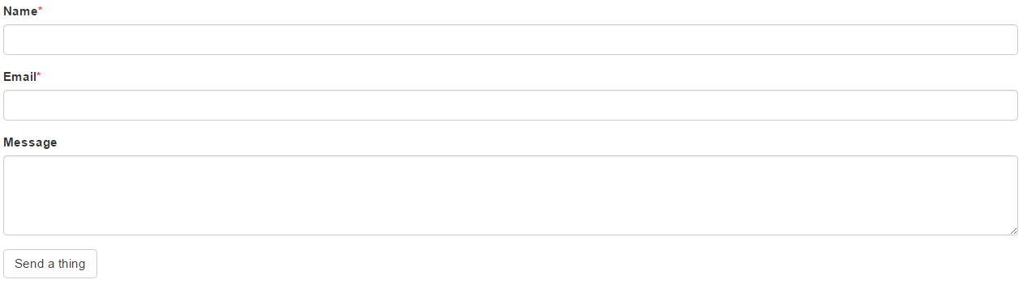
Multiple Molecules to Form an Organism

Slide 7
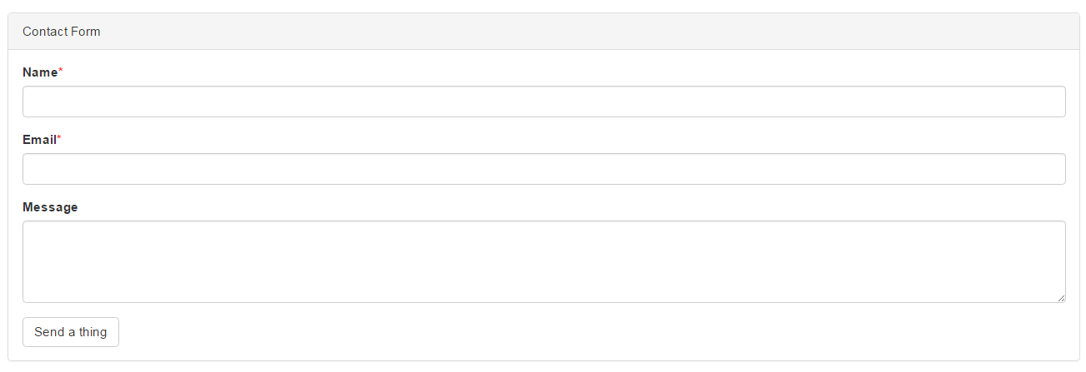
To Create a Template

Slide 8
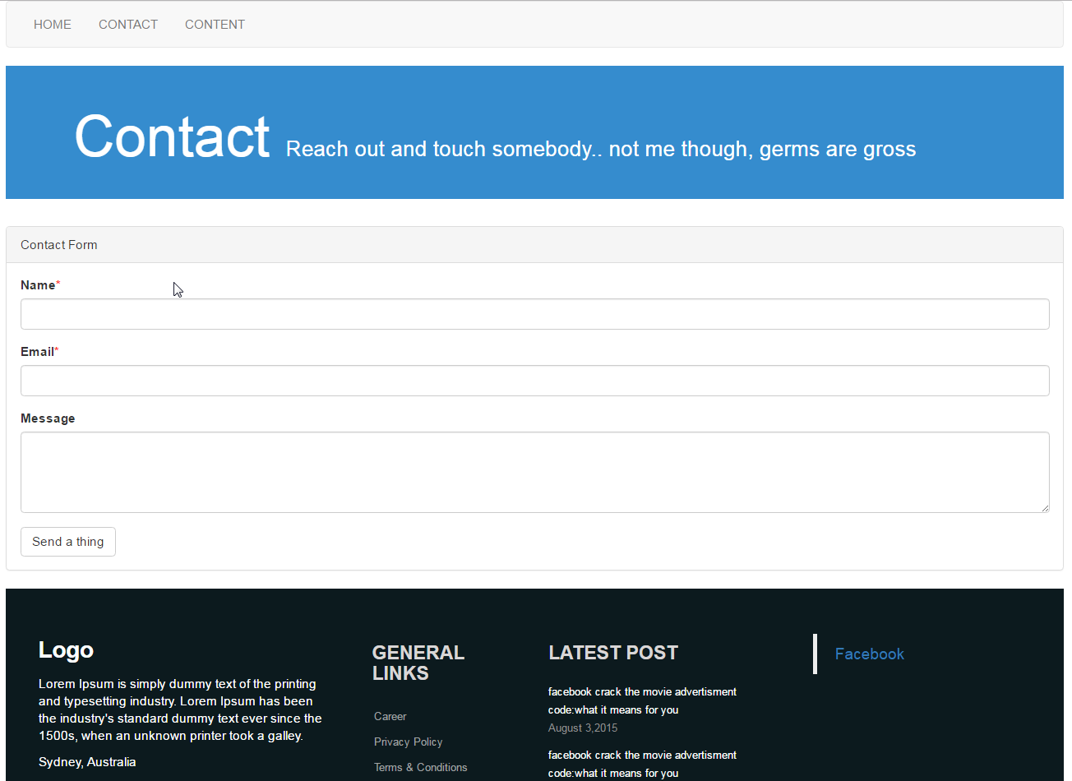
Working with other templates to become a page

Slide 9
How does this work with Angular?
Contact Page
Page Title
Contact Form
Page Footer
Title
Sub Title
Text Box
Text area
Submit Button
Details
Links
Latest
Social
Copyright

Slide 10
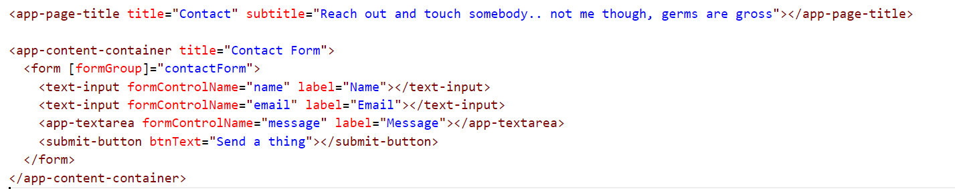
Makes HTML much easier to read

Slide 11
Making apps this way helps with UI changing UI frameworks
UI components created using atomic design are meant to be small but have large reaching effects
If a new date picker is released you only need to change a few files to have application wide effects
This is good and bad, its saved me many hours or work, but could very easily go wrong
MAKE SURE YOU TEST YOUR UI COMPONENTS!!

Slide 12
Recommendations when using Atomic Design with Angular
Create a style page
Helps on board people
Helps keep team members on the same page
Creates a single source of truth for UI components
Gives you a playground to test out ideas and new components
Don’t go overboard on granularity
Common sense is king
TEST YOUR UI COMPONENTS!!

Slide 13
AbstractValueAccessor
Implements ControlValueAccessor
Native Angular API interface
Bridge between angular control and UI element
Handles the read and write of the controls Value
Handles change/touch events that occur on control
Calls validate to perform validation that’s set on control

Slide 14
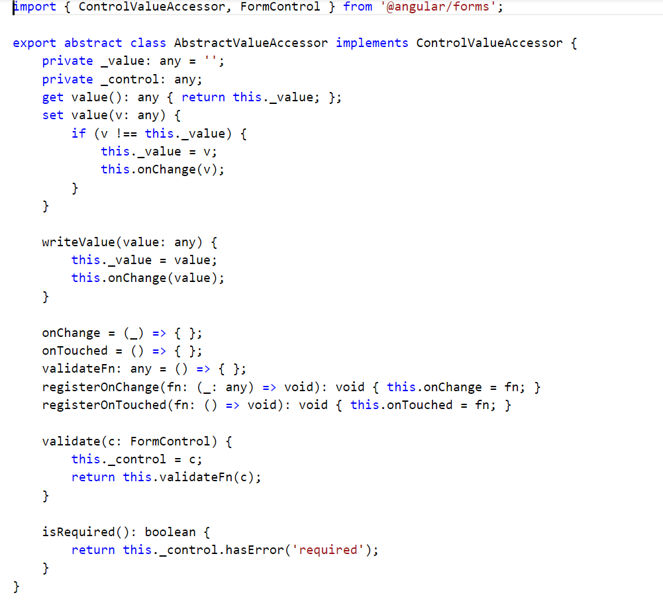
AbstractValueAccessor

Slide 15
MakeValueProvider
Handles dependency Injection for Component and Validator
Made in a generic way to be easily reuseable in different UI Components

Slide 16
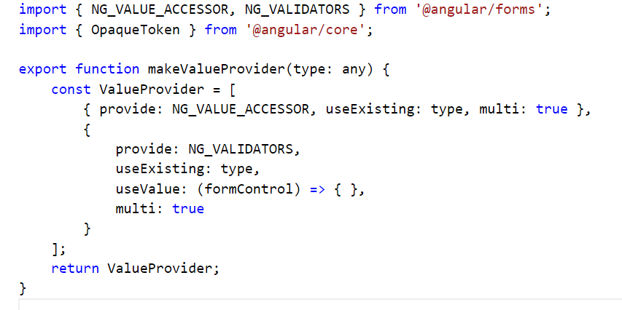
makeValueProvider

Slide 17
Implementing AbstractValueAccessor
Components that need to interact with form controls need to extend AbstractValueAccessor
MakeValueProvider function called in the provide meta-data to tell Angular how to handle the dependency injection

Slide 18
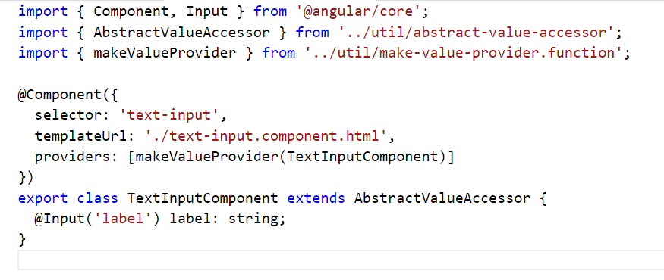
Implementing AbstractValueAccessor

Slide 19
CODE DEMO

Slide 20
Extra Reading
Atomic Design
http://bradfrost.com/blog/post/atomic-web-design/
http://atomicdesign.bradfrost.com/
Components pinched for the demo
http://bootsnipp.com/

Slide 21
Extra Reading cont…
AbstractValueAccessor
http://stackoverflow.com/questions/34948961/angular-2-custom-form-input
Custom Form Controls
http://blog.thoughtram.io/angular/2016/07/27/custom-form-controls-in-angular-2.html
A little old, but still relevant
Code Demo and Slides
https://github.com/evkw/ngSydneyDec

